Slide 1
DCA Members' Forum 2025
Rock Drilling
Mud-Motor versus Dual-Rod-System

Slide 2
Daily schedule
09:00 – 09:15 Welcome and Introduction
09:15 – 10:30 Workshop Session 1
10:30 – 11:00 Coffee break
11:00 – 12:30 Workshop Session 2
12:30 – 13:30 Lunch break
13:30 – 14:45 Workshop Session 3
14:45 – 15:15 Coffee break
15:15 – 16:30 Workshop Session 4
16:30 – 17:00 Final discussion

Slide 3
Welcome and Introduction
Brief introduction of the experts and the participants
Character of the Forum / Workshop
No classic lecture and no classic presentation Exchange of thoughts and opinions Discussions Joint development of results and conclusions
Why this topic?
Today's goals and expectations

Slide 4
Agenda
Session 1 History, technical structure, modes of action
History, BHA structure, mode of operation, deployed HDD-systems, ROPs, controllability, areas of application/application limits, (drilling lengths, radii, subsoil), equipment costs
Session 2 Measurement Methods/Positioning Methods in Comparison Walk-Over vs. Wire-Line, Wire-Line with Dual-Rod?, Accuracies, areas of application/limits of the measuring/locating methods, time required, costs
Session 3 Drilling fluid and borehole hydraulics
Fluid requirements, pump requirements, environmental aspects, Borehole cleaning, mud pressures, mud outbreaks, Borehole cleaning, costs for drilling fluid and wear and tear of the tools
Session 4 Comparison table/differentiation matrix and project examples
Comparison table/differentiation matrix, project examples

Slide 5
Session 1 – History, technical structure, modes of action
Brief history of the Mud-Motors and Dual-Rod-Systems
Technical Setup of systems and dimensions
HDD-systems used
Modes of action and power transmission (torque, speed, flow rates)
Rate of penetration
Controllability
Areas of application/application limits (drilling lengths, drilling radius, subsoil/geology, drag pipes)
Equipment costs incl. inspection and wear (also rods)

Slide 6
Session 1 – History, technical structure, modes of action
Brief history of the (drilling)Mud-Motors and Dual-Rod-Systems
Mud-Motors
In 1932, Moineau developed the positive displacement pump with stator and rotor End of the 1960s used in deep drilling technology In the 1980 standard tools in directional drilling for Oil & Gas Mud-Motors in HDD since 1980
Dual-Rod-Systems
First HDD-rig-manufacturer Ditch Witch, Mid-1990s
Other manufacturers are developing Dual-Rod-Systems
Dominant in rock drilling with drilling rigs with a pull-force of up to 30 t
Meanwhile also for drilling rigs with a pull- force of up to 60 t

Slide 7
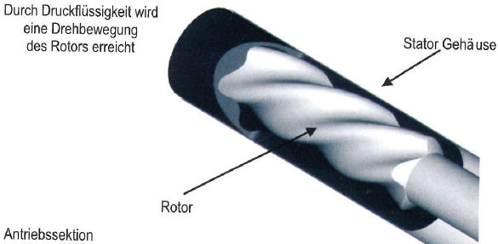
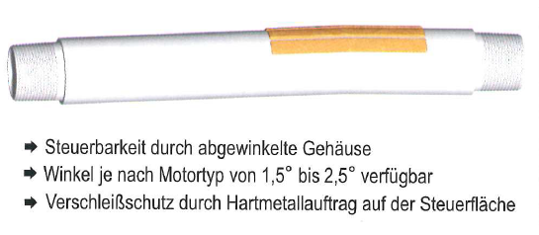
Session 1 – History, technical structure, modes of action
Technical design of the systems and dimensions
Mud-Motors
Quelle:
H.-J. Bayer, HDD-Praxis Handbuch
Quelle:
H.-J. Bayer, HDD-Praxis Handbuch

Slide 8
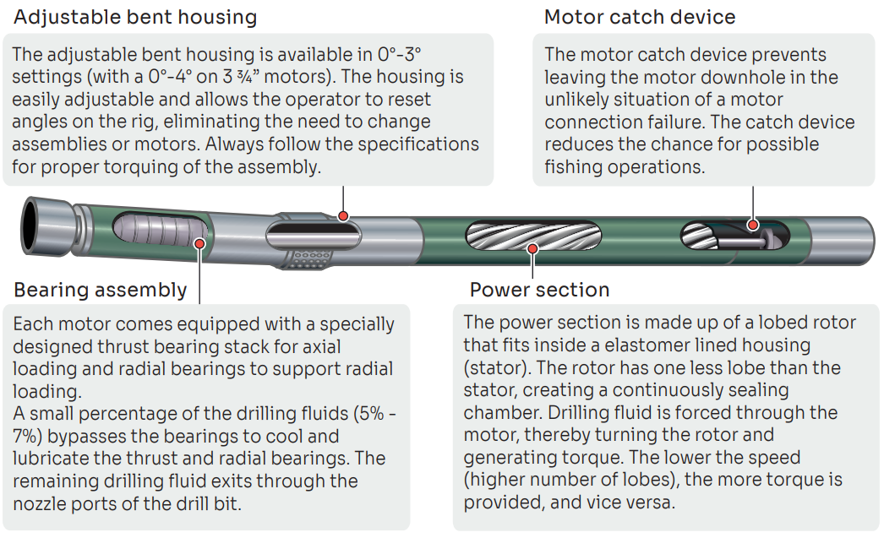
Session 1 – History, technical structure, modes of action
Technical design of the systems and dimensions
Mud-Motors
Quelle:
Prime Horizontal

Slide 9
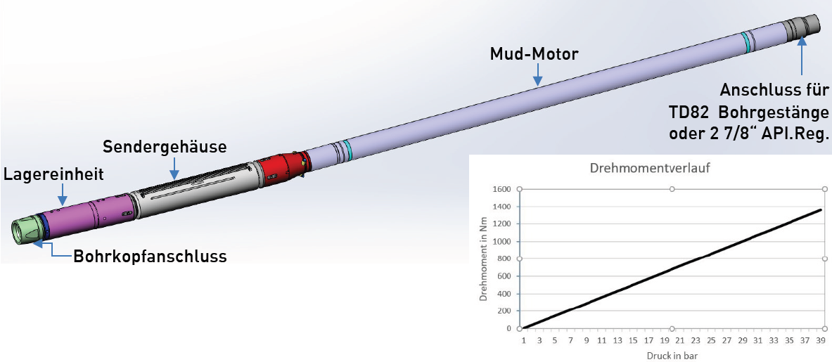
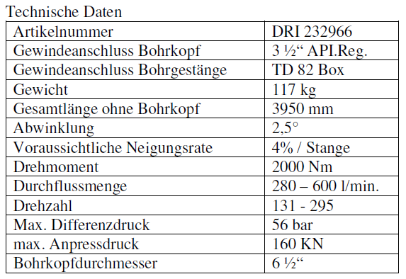
Session 1 – History, technical structure, modes of action
Technical design of the systems and dimensions
Mud-Motors (here in combination with rockbreaker unit)
Quelle:
Tracto-Technik
Quelle:
Tracto

Slide 10
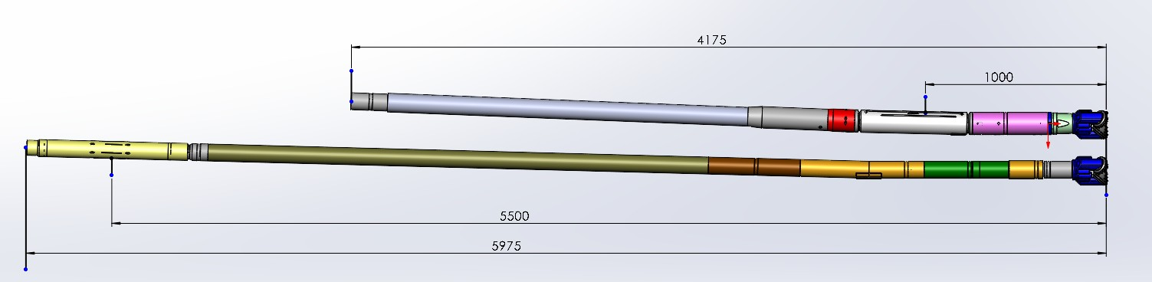
Session 1 – History, technical structure, modes of action
Technical design of the systems and dimensions
Mud-Motors
Comparison of the distance between the drill head and the transmitter at
Mudmotor Standard 3-¾“
Mudmotor in combination with Rockbreaker 3-3/4"
Quelle:
Tracto-Technik

Slide 11
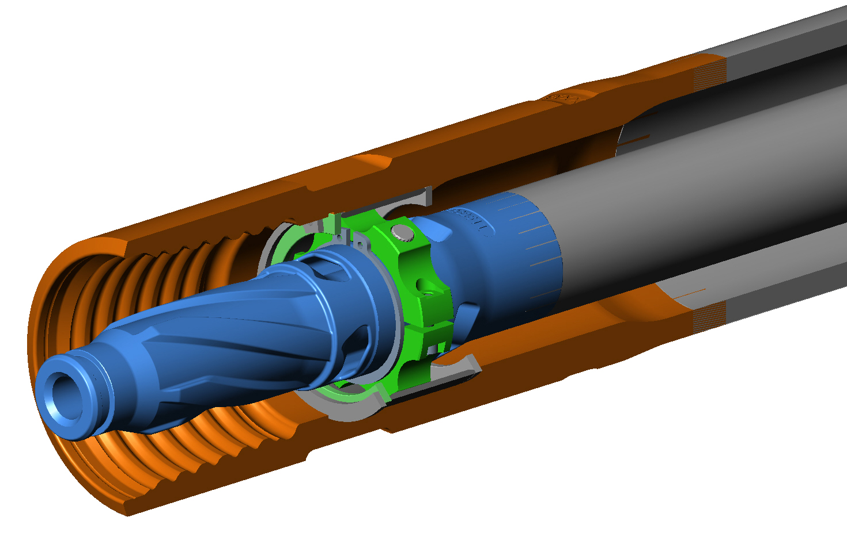
Session 1 – History, technical structure, modes of action
Technical design of the systems and dimensions
Drive of the bit via internal drill pipe
Dual-Rod-Systems
Dual-Rod-System / Double-Rod-System
Quelle:
H.-J. Bayer, Tracto Technik

Slide 12
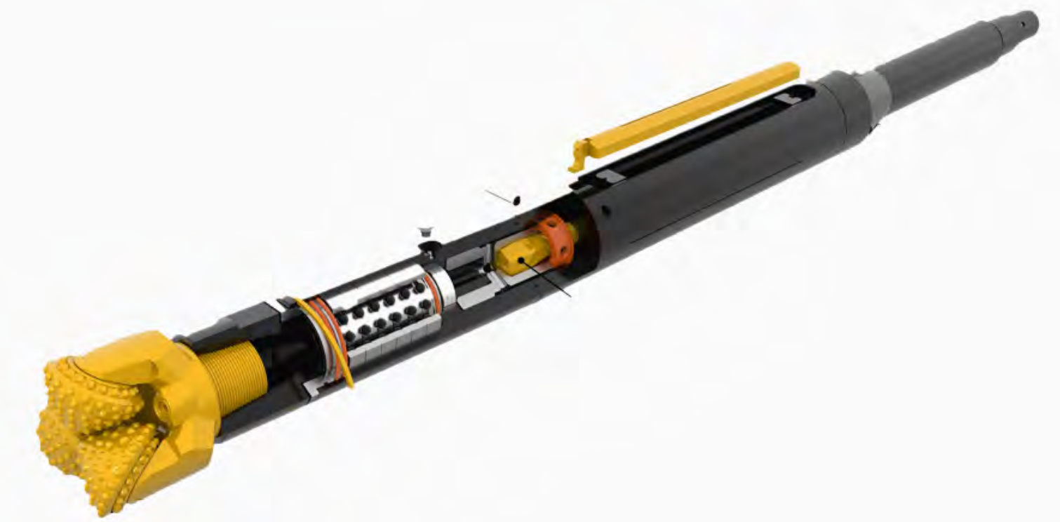
Session 1 – History, technical structure, modes of action
Technical design of the systems and dimensions
Dual-Rod-System
Rockmaster
Housing
Sender / Transmitter
Quelle:
Borestore.com/Vermeer

Slide 13
Session 1 – History, technical structure, modes of action
Deployed HDD-Systems
with Dual-Rod-System
mini, midi, and "small" maxi rigs from different manufacturers
with 12 t, 18 t, 30 t, 54 t max. pull force
with Mud-Motors
midi, maxi and mega rigs from various manufacturers
with 15 t, 18 t, 28 t, 30 t, 45 t, 60 t to 600 t max. pull force
In this forum, we want to compare the systems for HDD-systems from 18 t – 54 t !!

Slide 14
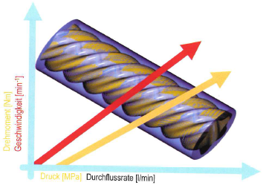
Session 1 – History, technical structure, modes of action
Modes of action and power transmission (torque, speed, flow rates)
Quelle:
H.-J. Bayer, HDD-Praxis Handbuch
Mud-Motors (for 18t-54t Rigs)
Power transmission by converting hydraulic energy into mechanical energy
Torques: 500-3.000 Nm
Speeds: 100-250 1/min
Flow: 250-1.000 l/min
(for pilot drilling)

Slide 15
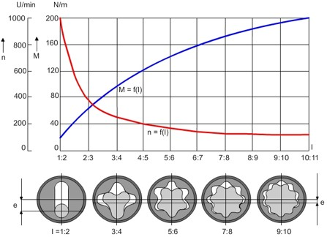
Session 1 – History, technical structure, modes of action
Modes of action and power transmission (torque, speed, flow rates)
Mud-Motors
Relationship between torque/speed according to the number of gears of the motors
Quelle:
"Flachbohrtechnik" von Werner Arnold

Slide 16
Session 1 – History, technical structure, modes of action
Modes of action and power transmission (torque, speed, flow rates)
Dual-Rod-System
(for 18t-54t Rigs)
Power transmission through internal linkage
Torques: 1.200-3.000 Nm
Speeds: 50-350 1/min
Flow: 60-150 l/min
(for pilot drilling)
Quelle:
H.-J. Bayer, Tracto Technik

Slide 17
Session 1 – History, technical structure, modes of action
Rate of penetration
Are there differences between the two systems (possibly due to different torques, speeds and contact pressures)?
Dual-Rod-Systems
Mud-Motors
No significant difference !!
Or ???

Slide 18
Session 1 – History, technical structure, modes of action
Controllability
Factors influencing controllability:
Geology Geometry and dimensions Bent Sub Rigidity/Stiffness of the system
What exactly is meant by controllability? Discussion
Are there differences in controllability here? Discussion
Dual-Rod-Systems
Mud-Motors
What differences?

Slide 19
Session 1 – History, technical structure, modes of action
Areas of application/limits of application (drilling lengths, drilling radius, subsoil/geology, string behind reamer)
Drilling lengths
What factors have a significant influence on the possible drill lengths?
Drilling rig used Power Transmission and Losses per System Possible Pumping Rates for Mud-Motors
Dual-Rod-Systems (18 t, 30 t, 54 t class)
Drilling lengths approx.: 200-300 m (18 t) 300-400 m (30 t) 400-600 m (54 t), or more??
Subsoil (geology): Rock, inhomogeneous ground
Mud-Motors (18 t, 30 t, 54 t class)
Drilling lengths approx.: 200-350 m (18 t) 300-450 m (30 t) 400-650 m (54 t), or more??
Subsoil (geology): Rock, inhomogeneous ground

Slide 20
Session 1 – History, technical structure, modes of action
Areas of application/application limits (drilling lengths, drilling radius, subsoil/geology, drag pipes)
Possible drill radii
What factors have a significant influence on the minimum drill radii?
Geology Geometry and dimensions (including bits) Bent Sub Stiffnes of the system
Dual-Rod-Systems
(under optimal conditions)
18 t Class 50 m
30 t Class 65 m
54 t Class 65 m
Mud-Motors
(under optimal conditions)
18 t Class 100 m (3 3/4 75 m with Rockbreaker)
30 t Class 100 m
54 t Class 100 m

Slide 21
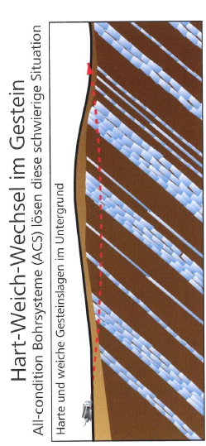
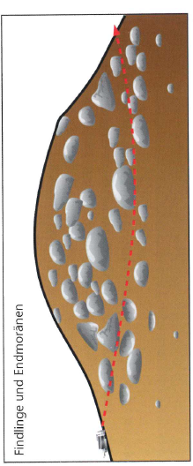
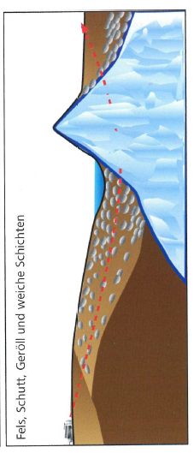
Session 1 – History, technical structure, modes of action
Areas of application/limits of application (subsoil/geology) for Dual-Rod-Systems
Factors for drillability in hard-soft alternation in rock:
Mud Flow
RPM (rotations per minute)
ROP (rate of penetration, Speed)
Steerability
Reaction-/Correction time
Quelle (alle Bilder):
H.-J. Bayer u. M. Reich , HDD -Felsbohrtechnik

Slide 22
Session 1 – History, technical structure, modes of action
Areas of application/application limits (drilling lengths, drilling radius, subsoil/geology, drag pipes)
Use of drill pipe behind reamer
Dual-Rod-Systems
Mud-Motors
very time-consuming, but possible
Easy

Slide 23
Session 1 – History, technical structure, modes of action
Equipment costs incl. inspection and wear (also drill pipe)
Dual-Rod-Systems
Purchase price: approx. 9,000 -14,000 EUR for the Rockmaster (without bit)
Inspection: approx. 1,000-2,000 EUR every 100 operating hours
Wear: rather high, because less or incorrect drilling fluid is pumped ??
Costs of rods: rather high in comparison (inner and outer drill pipe)
Mud-Motors
Purchase price: approx. 25,000 EUR 3 3/4 inches, 30.000 EUR 4 3/4 inches approx. 40,000 EUR 6 3/4 inches (without bit) (Often rental)
Inspection: approx. 2,000-2,400 EUR every 150 operating hours
Wear: rather low, because significantly more drilling fluid is pumped
Costs of rods: rather low in comparison

Slide 24
Session 2 – Measurement Methods/Positioning Methods in Comparison
Locating technology Walk-Over for Dual-Rod-System
Locating technology Walk-Over for Mud-Motor
Locating technology Wire-Line for Mud-Motor
Wire-Line drilling for Dual-Rod-Systems???
Accuracies of the different positioning/locating systems
Areas of application/application limits (drilling depth, drilling lengths, battery life)
Time required for pilot drilling
Costs for measurement technology / location technology incl. operation in comparison

Slide 25
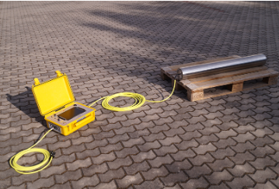
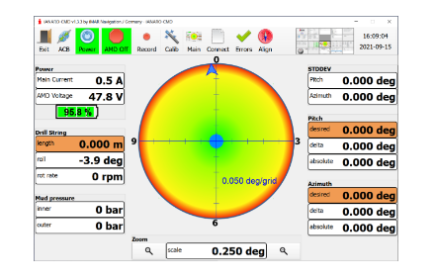
Session 2 – Measurement Methods/Positioning Methods in Comparison
Locating Method Walk-Over
Measurement Wire-Line for Mud-Motor
Quelle:
H.-J. Bayer, Tracto-Technik
Quelle:
iMAr Navigation GmbH

Slide 26
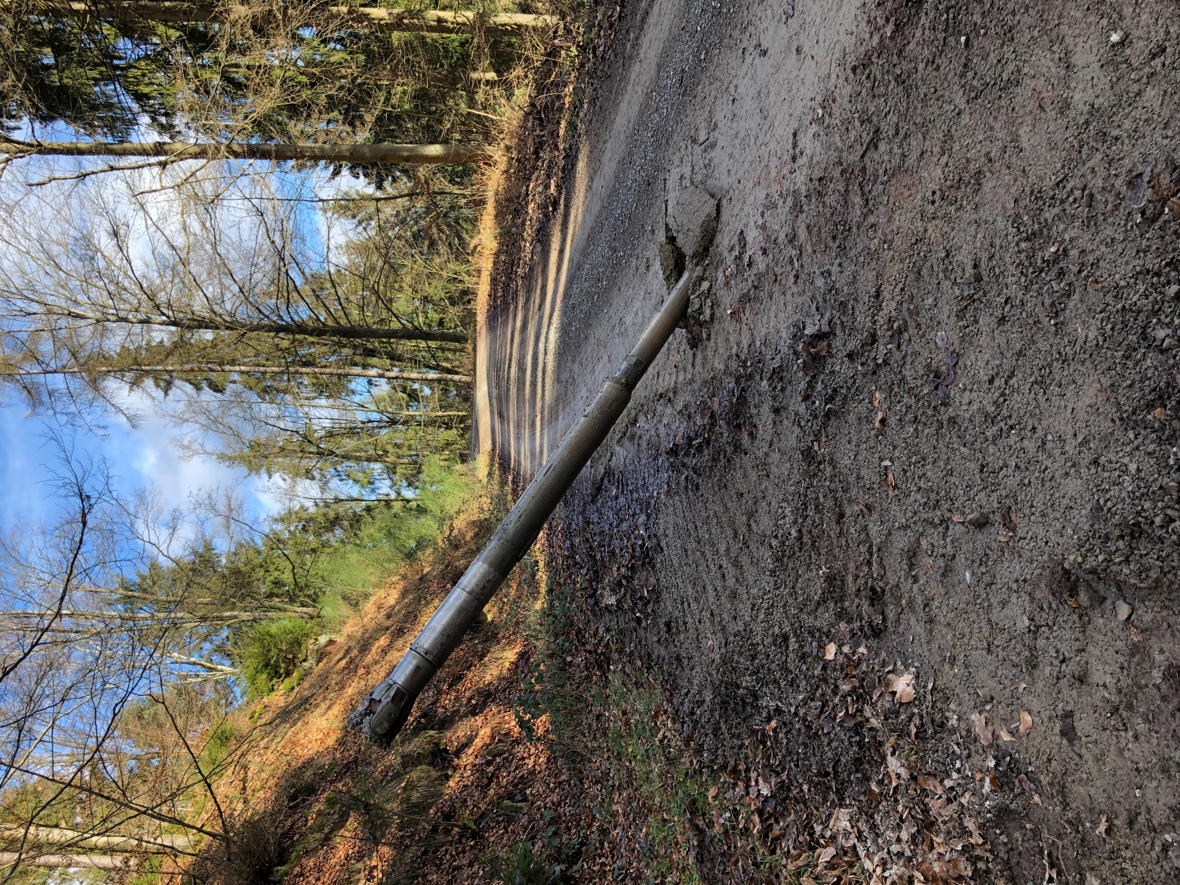
Session 2 – Measurement Methods/Positioning Methods in Comparison
Locating Methods Walk-Over for Dual-Rod-System
All companies in the field of small
use drilling technology Walk-Over successfully
Drilling with Wire-Line
is currently not possible
With Walk-Over jobs can be
executed with good precision
Precision landing after 200 m in the Black Forest in sandstone and with 160 m
altitude difference, 18 t drilling rig
Quelle:
LEONHARD WEISS

Slide 27
Session 2 – Measurement Methods/Positioning Methods in Comparison
Locating Methods Walk-Over for Mud-Motors
Has been practiced in small scale drilling technology
for years
Many drilling companies/rig operators have never
drilled with Mud-Motors
Location of bit not equal to location of the
located transmitter because there is greater distance
between bits and transmitter (sometimes 4-5m,
depending on the system)
Increased "calculation effort" for the Drill master
to pass on control commands
Quelle:
LEONHARD WEISS

Slide 28
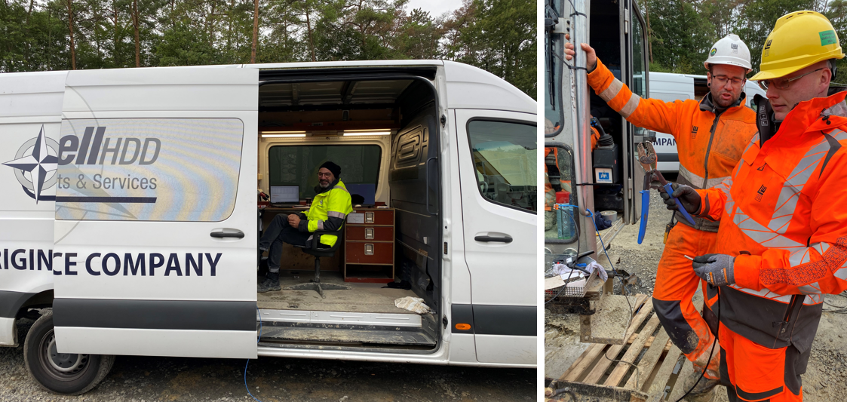
Session 2 – Measurement Methods/Positioning Methods in Comparison
Measurement Methods/Locating Methods Wire-Line for Mud-Motors (here Gyro)
Common combination in large-scale HDD
In small drilling technology < 40 t, gyros were often too "big" because necessary torques in rock could not be achieved for the required bits
-> slimmer gyros have been designed that can
also be used for drilling rigs < 40 t
Some drilling companies drill with "slimmer" gyros regularly
Quelle:
LEONHARD WEISS

Slide 29
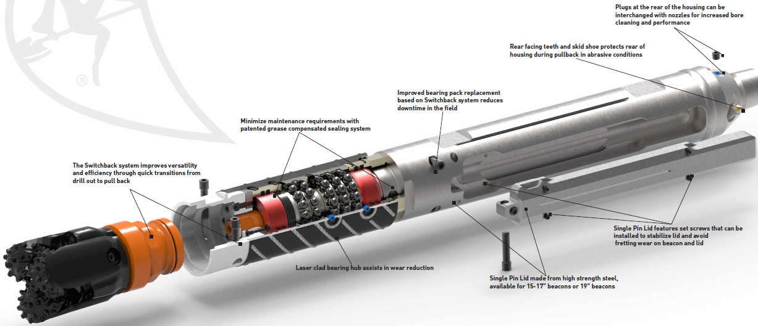
Session 2 – Measurement Methods/Positioning Methods in Comparison
Cable-guided/Wire-Line drilling for Dual-Rod-Systems?
Quelle:
Ditch Witch

Slide 30
Session 2 – Measurement Methods/Positioning Methods in Comparison
Accuracies of the different positioning systems
Walk-Over
According to the manufacturer, locating technology 5 %, but empirical values are more likely to be about 2-3 % of the cover as a deviation in all directions In the case of active or passive disturbances, however, significantly higher deviations or locating is not possible at all Deviations also depend on the human factor / experience
Wire-Line (Gyro)
Measurement engineer necessary Measurement methods should be combined with positioning methods Deviations usually low and continuous monitoring of target/actual deviations Accuracy azimuth 0.1°, inclination angle 0.05°, roll angle 0.5°, 0.1% of drilling length

Slide 31
Session 2 – Measurement Methods/Positioning Methods in Comparison
Areas of application/application limits (drilling depth, drilling lengths, battery life)
Walk-Over
Drilling depth limited due to signal strengths; at max. 15m – 20m (30m with depth probe) depending on geology and electromagnetic interference fields (active and passive) Danger of low battery power with too long drilling time - > longer drilling lengths sometimes critical
Wire-Line (Gyro)
Measuring method virtually independent of the laying depth and independent of magnetic influences Power supply via cable - > longer drilling lengths no problem (cf. battery life walk-over) Risk of faulty cable connections or cable breaks

Slide 32
Session 2 – Measurement Methods/Positioning Methods in Comparison
Time required for pilot drilling
Dual-Rod-System with Walk-Over:
Screwing/connecting inner and outer rods
Mud-Motor with Wire-Line (Gyro):
Cable connection 2-3 min
Small advantage for double drill pipe system !

Slide 33
Session 2 – Measurement Methods/Positioning Methods in Comparison
Costs for measurement technology/location technology incl. operation in comparison
Dual-Rod-System with Walk-Over:
Low cost of measurement
Mud-Motor with Wire-Line (Gyro):
High cost of measurement
-> approx. 3.000 €/d - 4.000 €/d additional
Clear advantage for walk-over or double rod system !

Slide 34
Session 2 – Measurement Methods/Positioning Methods in Comparison
Advantages/disadvantages of Walk-Over compared to Gyro
 | Walk-Over Procedure | Wire-Line Procedure with opt. Gyro
Advantages: | Low costs | independent of drilling depth
 | Fast measurement | Good radius monitoring
 | No cable required | Very accurate angle measurement
 | Robust systems | No magn. Interference
 |  | Pressure measurement possible
 |  | Long drilling lengths possible
Disadvantages: | lower accuracy | only calculated positions
 | Limited drilling depth | High costs
 | Limited drilling lengths (battery life) | Wireline necessary in drill pipe
 | No monitoring of radii | sensitives Messsystem
 | mag. Interference high

Slide 35
Session 3 – Drilling Fluid and Downhole Hydraulics
Water Demand / Suspension Requirements, Pumping Rates Pump Requirements per System Water availability and environmental regulations Borehole cleaning (cutting beds, washouts in the borehole due to high pressures or speeds) Flushing pressures of both systems Probability of mud break-outs Comparison of the costs for suspension requirements Comparison of wear costs on tools

Slide 36
Session 3 – Drilling Fluid and Downhole Hydraulics
Water Demand / Flushing Requirements, Pumping Rates (Pilot Drilling)
Dual-Rod-Systems
18 t Class 60-100 l/min
30 t Class 60-120 l/min
54 t Class 120-150 l/min
Mud-Motors
18 t Class 250-300 l/min
30 t Class 300-500 l/min
54 t Class 500-1000 l/min
Significant advantage for Dual-Rod-System !

Slide 37
Session 3 – Drilling Fluid and Downhole Hydraulics
Pump Requirements per System, reaming (change system pilot reaming??)
Dual-Rod-Systems
18 t Class 60-100 l/min
30 t Class 60-120 l/min
54 t Class 120-150 l/min
Mud-Motors
18 t Class 250-300 l/min
30 t Class 300-500 l/min
54 t Class 500-1000 l/min
Smaller pumps necessary for pilot drilling!
BUT: No difference while reaming !!
Same pumps needed for pilot drilling and reaming!

Slide 38
Session 3 – Drilling Fluid and Downhole Hydraulics
Water availability and environmental regulations
The amount of water allowed to take from the public network or a river/stream may be limited, due to:
Possible overloading of the water supply network Environmental regulations that limit water abstraction, esp. in summer
Clear advantage with lower suspension requirements for pilot drilling !
BUT: During reaming process, the need for flushing is higher again and there is no difference between the two systems !!

Slide 39
Session 3 – Drilling Fluid and Downhole Hydraulics
Borehole cleaning (Cutting-Beds, Washout in the borehole due to high pressures or velocities)
Cleaning the bottom of the borehole
Better discharge/cleaning and less
Cutting-Beds with higher flushing quantity (-speed) so advantage for Mud-Motors !
Dual-Rod-Systems
Mud-Motors
But: Risk of washout in the borehole due to high volumes!? Discussion

Slide 40
Session 3 – Drilling Fluid and Downhole Hydraulics
Annular Mud pressures of both systems
Dual-Rod-Systems
Usual pressures: ________ bar
Mud-Motors
Usual pressures: ________ bar
(Measuring annular pressure not possible with Dual rod system)
Significantly higher pressures at higher pumping rates at Mud-Motor drilling!

Slide 41
Session 3 – Drilling Fluid and Downhole Hydraulics
Probability of mud break outs
Dual-Rod-Systems
Mud-Motors
Due to higher pressures and pumping rates, there is also a higher risk of Mud-Motor drilling for mud breakouts/Inadvertent returns!
(measuring annular pressure and better hole cleaning may result in lower risk)

Slide 42
Session 3 – Drilling Fluid and Downhole Hydraulics
Comparison of the costs for drilling fluid
Key Types of Costs
Water supply (transport costs)
Drilling fluid products (bentonites, polymers)
Drilling fluid separation/treatment costs (personnel, equipment)
Transport/Disposal costs (120-200 EUR/m3)
Dual-Rod-Systems advantage, because significantly less flushing is needed for the pilot drilling !
Dual-Rod-Systems
Mud-Motors
Again! The cost advantage only applies to the pilot drilling! And if no recycling is used

Slide 43
Session 3 – Drilling Fluid and Downhole Hydraulics
Comparison of wear costs on tools
Dual-Rod-Systems
Mud-Motors
Mud-Motors advantageous because significantly more flushing is used in the pilot drilling, which significantly reduces wear on tools and rods!
Again! The cost advantage only applies to the pilot drilling!

Slide 44
Session 4 – Comparison Table/Distinction Matrix and project examples
Comparison Table/Distinction Matrix project examples

Slide 45
Session 4 – Comparison Table/Distinction Matrix
Criterion | Subsoil | Subsoil | Subsoil | Drilling Length | Drilling depths | Drilling radii
 | Rock, |  |  | [m] | [m] | [m]
 | changeable | Fels, homogen | Blocks, stones, Molar dense
System | with bind. Zon. |  | stored
Influencing factor | Geomet. BHA | Geomet. BHA | Geomet. BHA | System | Measurement | Geomet. BHA
Mud-Motor |  |  |  |  | with Gyro!
18 t | ++ | ++ | -- | 200-300 | without limit | 80
30 t | ++ | ++ | -- | 300-400 | without limit | 100
54 t | ++ | ++ | -- | 400-600 | without limit | 130
Doppelbohrgestänge/
Dual Rod
18 t | ++ | ++ | - | 200-300 | 15-20 (40m) | 50 (-80)
30 t | ++ | ++ | - | 300-400 | 15-20 (40m) | 65 (-80)
54 t | ++ | ++ | - | 400-600 | 15-20 (40m) | 65 (-80)
Wertungs-System: | + | suitable | ++ | Well suited
 | - | less suitable | -- | unsuitable

Slide 46
Session 4 – Comparison Table/Distinction Matrix
Criterion | Accuracy | Controllability | Rate of penetration | Water- | Quantity | Annular Pressure
 |  |  |  | requirement | Drilling Fluid/
 |  |  |  |  | Pumprates
System |  |  |  |  | [l/min]
Influencing factor | Geomet. BHA | Geomet. BHA | System | System | System | System
Mud-Motor | Wireline | Wireline |  | (at pilot drilling)
18 t | ++ | + | no difference | high | 250-300 | Normal
30 t | ++ | + | no difference | high | 300-500 | Normal
54 t | ++ | + | no difference | high | 500-1000 | Normal
Doppelbohrgestänge/ |  |  |  | (at pilot drilling)
Dual Rod
18 t | + | 0 | no difference | Low | 60-100 | Lower
30 t | + | 0 | no difference | Low | 60-120 | Lower
54 t | + | 0 | no difference | Low | 120-150 | Lower

Slide 47
Session 4 – Comparison Table/Distinction Matrix
Criterion | Cost | Floor space | Wear
 | Drill String |  | Tool
System
Influencing factor | System Structure | Dimensions | System/Pumprate
Mud-Motor
18 t | less | higher | small
30 t | less | higher | small
54 t | less | higher | small
 |  |  | dependent on
Doppelbohrgestänge/ |  |  | Pumprate
Dual Rod
18 t | higher | less | higher
30 t | higher | less | higher
54 t | higher | less | higher

Slide 48
Session 4 – project examples
Project SuedLink, Crossings Eubigheimer Tal
Contractor: LEONHARD WEISS GmbH & Co. KG

Slide 49
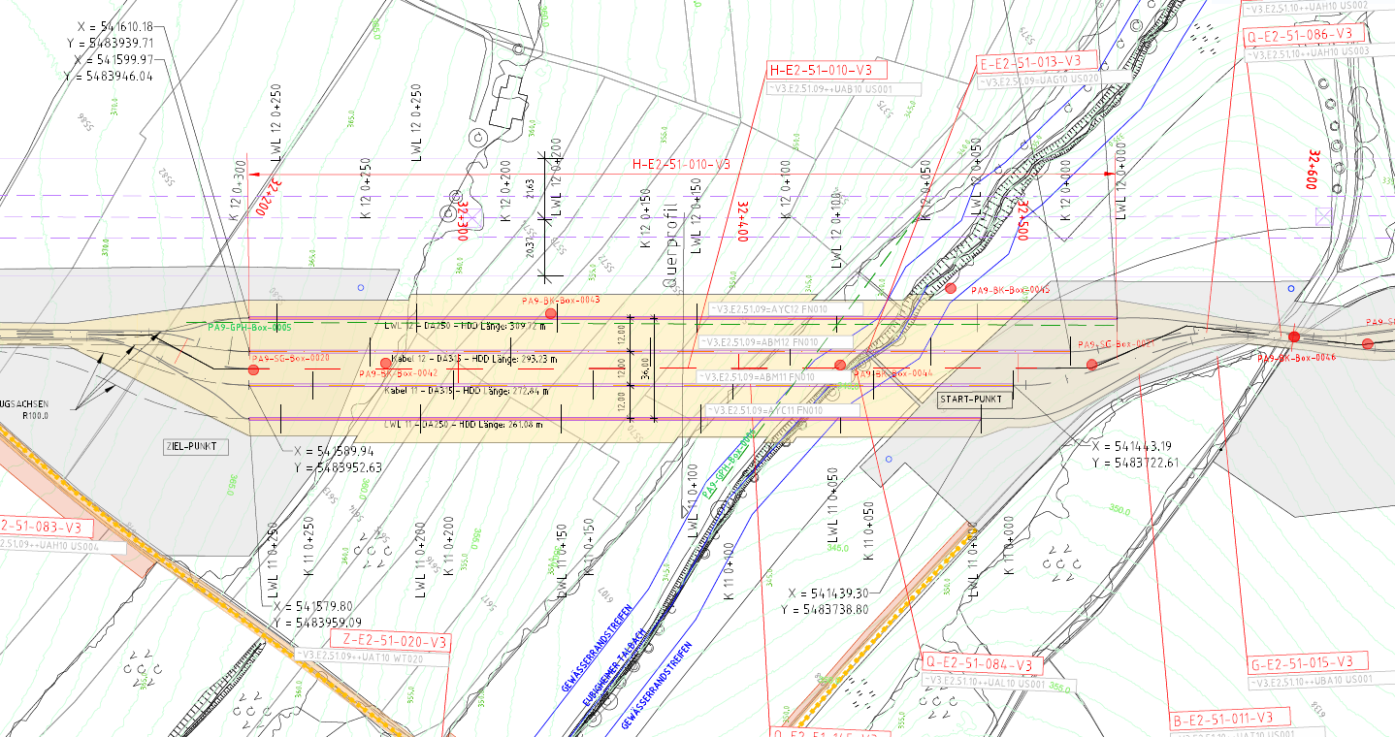
Crossings Eubigheimer Valley plan view
overground power line
LKWs mit Mischanlage
HDD-System 30 t
Radlader
Tanks
Aufenthaltscontainer
1 x 250 mm and 2 x 315 mm PE-pipes + 50 mm or 75 mm ducts
Radbagger
Quelle:
Lageplan
TransnetBW/
iLF Consulting Engineers
2. HDD-System 28 t t

Slide 50
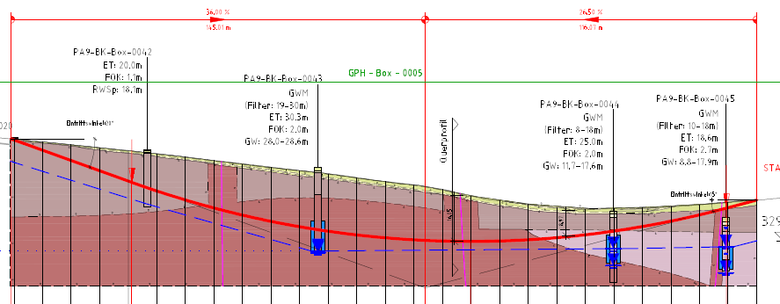
Crossings Eubigheimer Valley cross section
LKWs mit Mischanlage
HDD-System 30 t
Radlader
Tanks
Aufenthaltscontainer
Radbagger
2. HDD-System 28 t t
Quelle:
Längsschnitt
TransnetBW/
iLF Consulting Engineers

Slide 51
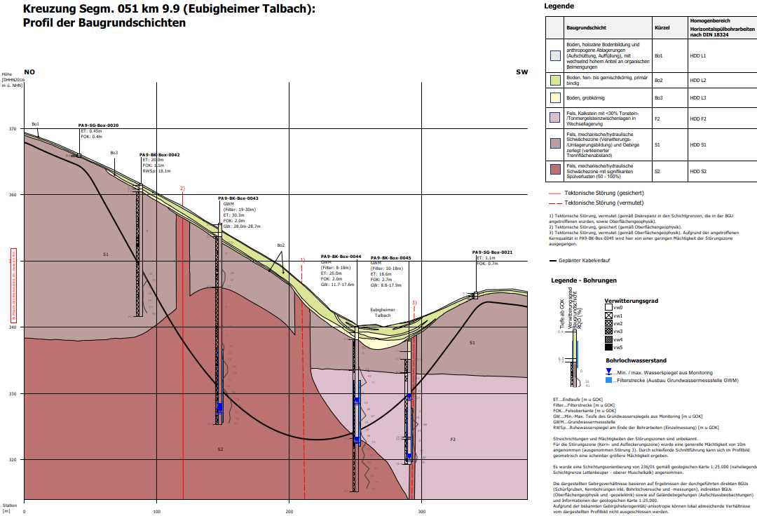
Crossings Eubigheimer Valley geology
LKWs mit Mischanlage
HDD-System 30 t
Radlader
Tanks
Quelle:
Geotechnische Bericht
TransnetBW/
iLF Consulting Engineers
Aufenthaltscontainer
Radbagger
2. HDD-System 28 t t

Slide 52
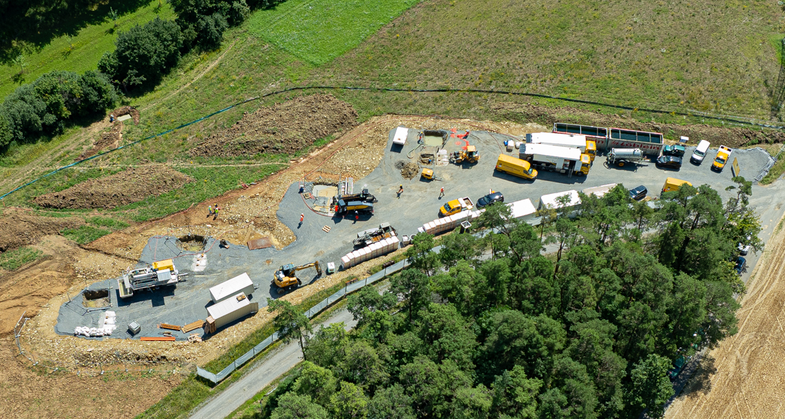
Project SuedLink, Crossings Eubigheimer Valley
Trucks with mixing unit
HDD-system 30 t
Wheel loader
Water tanks
Mud separation with centrifuge
Vacuum unit
Containers
Wheel excavator
2. HDD-system 28 t
Quelle:
LEONHARD WEISS GmbH & Co. KG

Slide 53
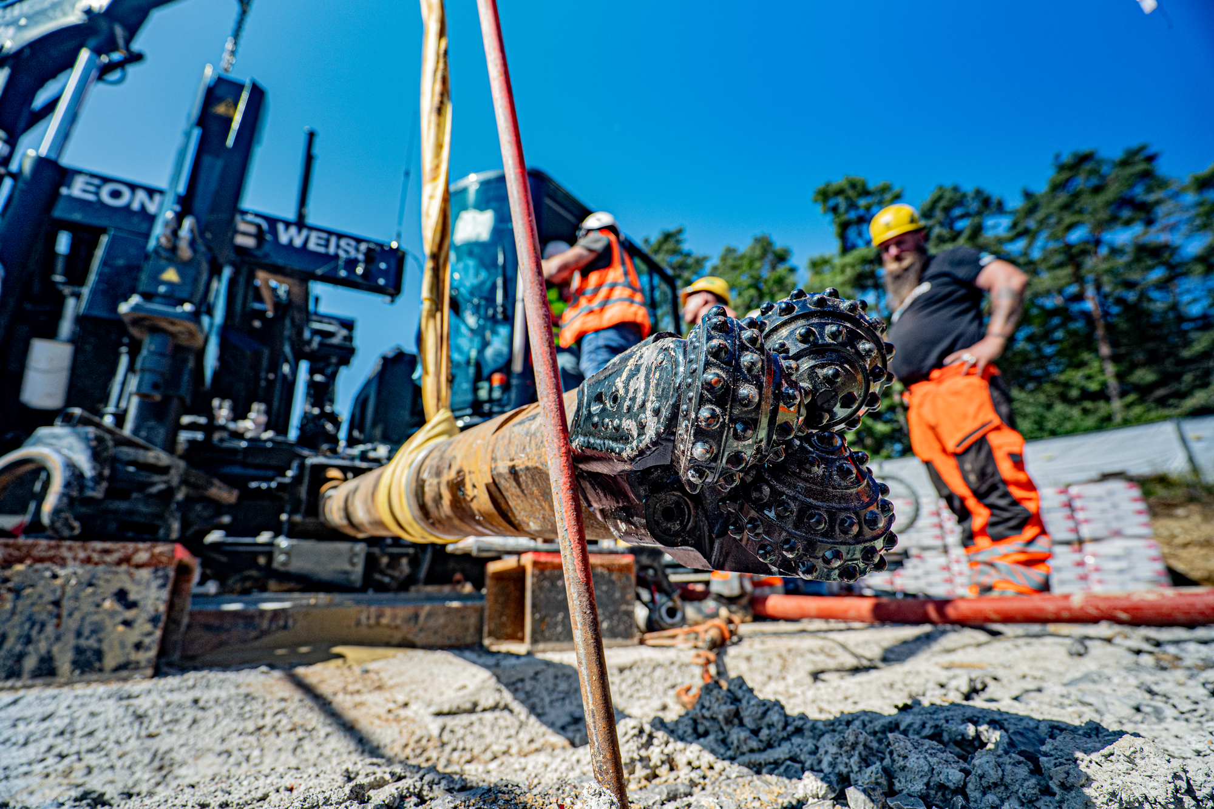
Rockmaster (double-rod) with walk-over-system
Quelle:
LEONHARD WEISS GmbH & Co. KG

Slide 54
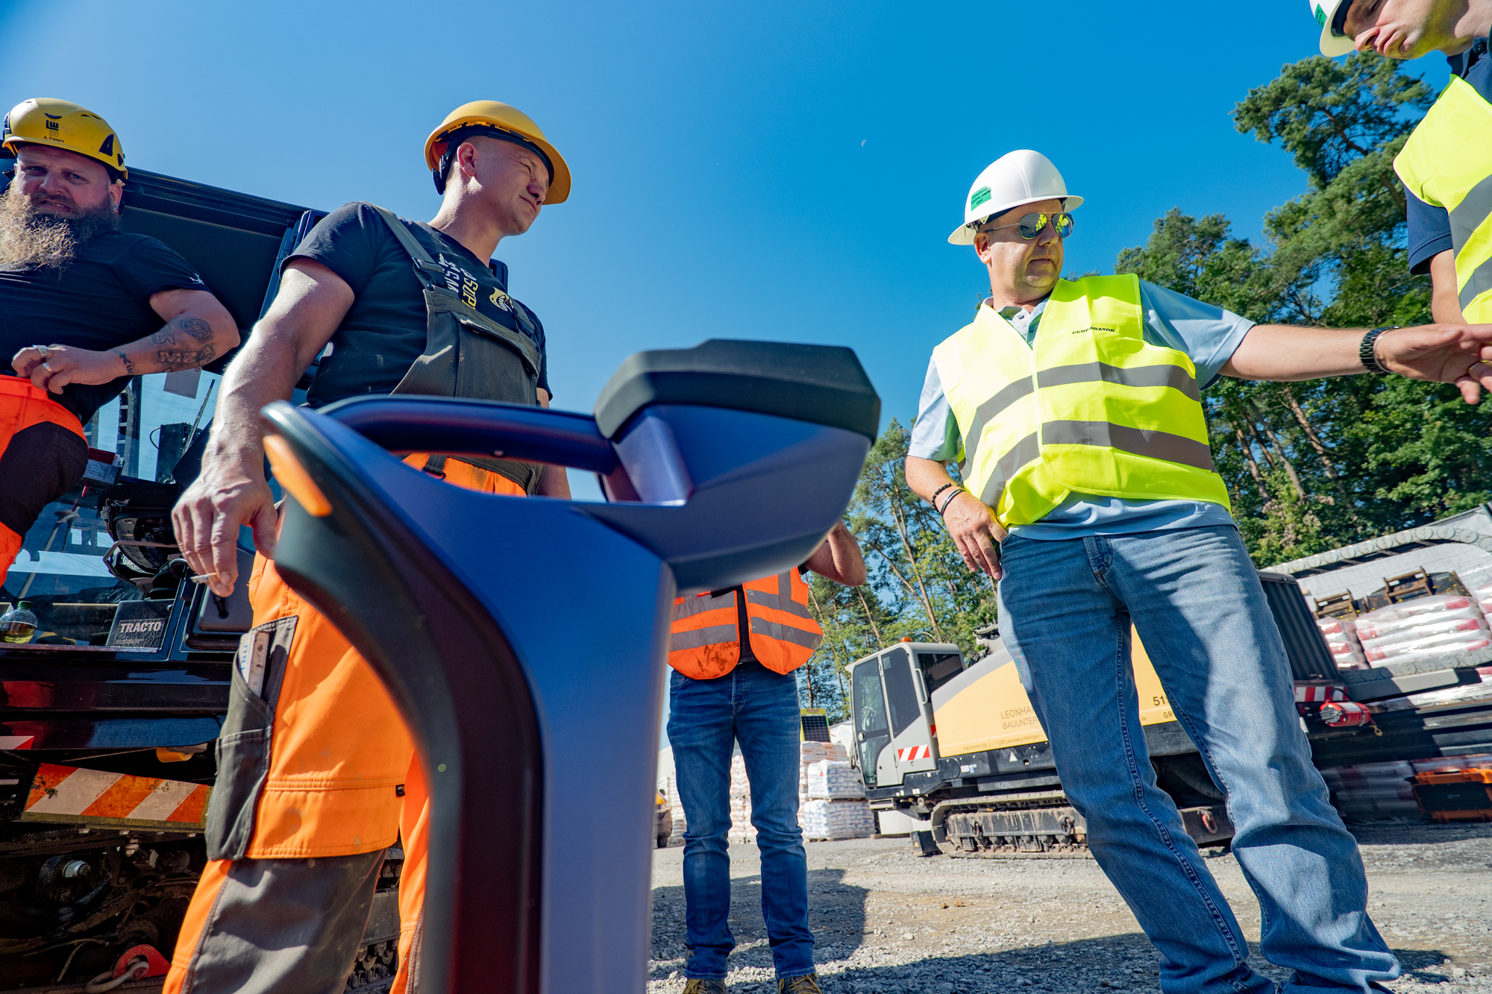
„New“ walk-over-system (from U.S.) in action
Quelle:
LEONHARD WEISS GmbH & Co. KG

Slide 55
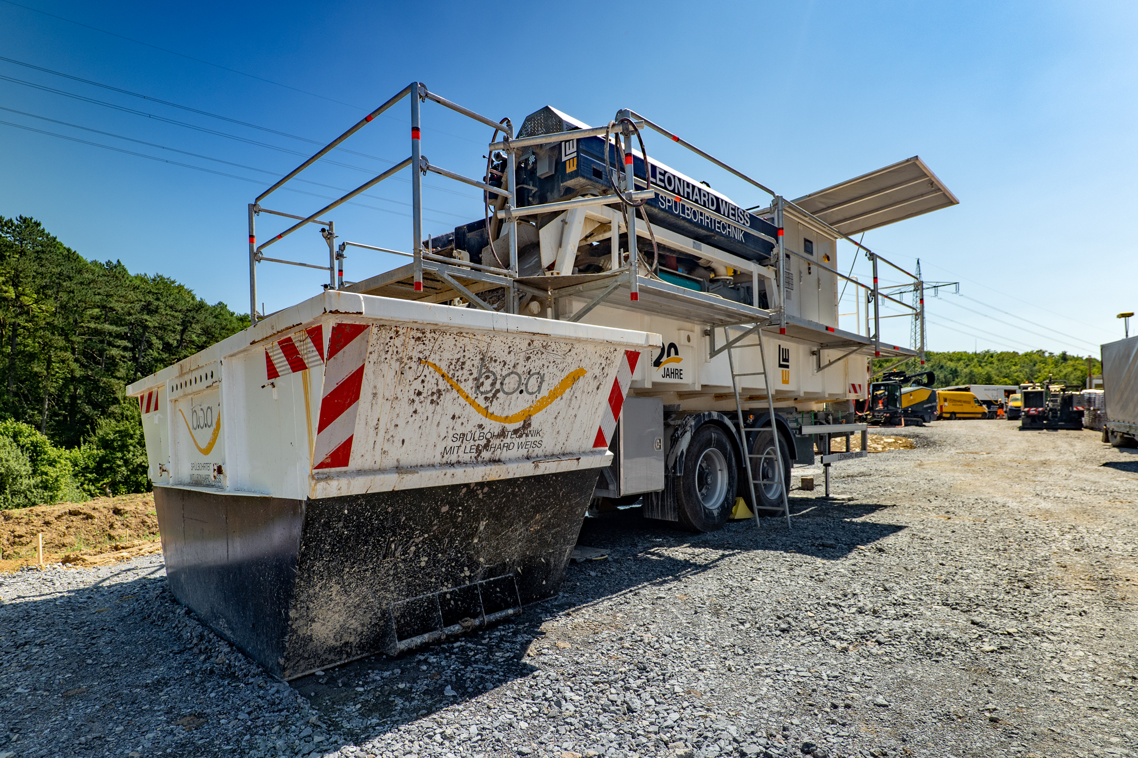
Mud separation with centrifuge
Quelle:
LEONHARD WEISS GmbH & Co. KG

Slide 56
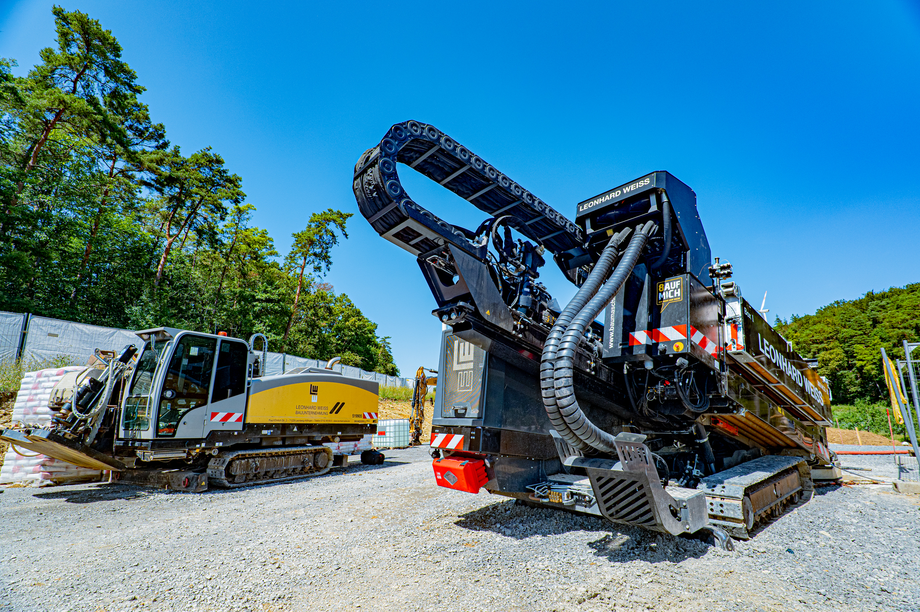
2 rigs on one job site
After the conversion of Dual-Rod-System to Mud-Motor,
more powerful generator sets and pumps also had to be used
Quelle:
LEONHARD WEISS GmbH & Co. KG

Slide 57
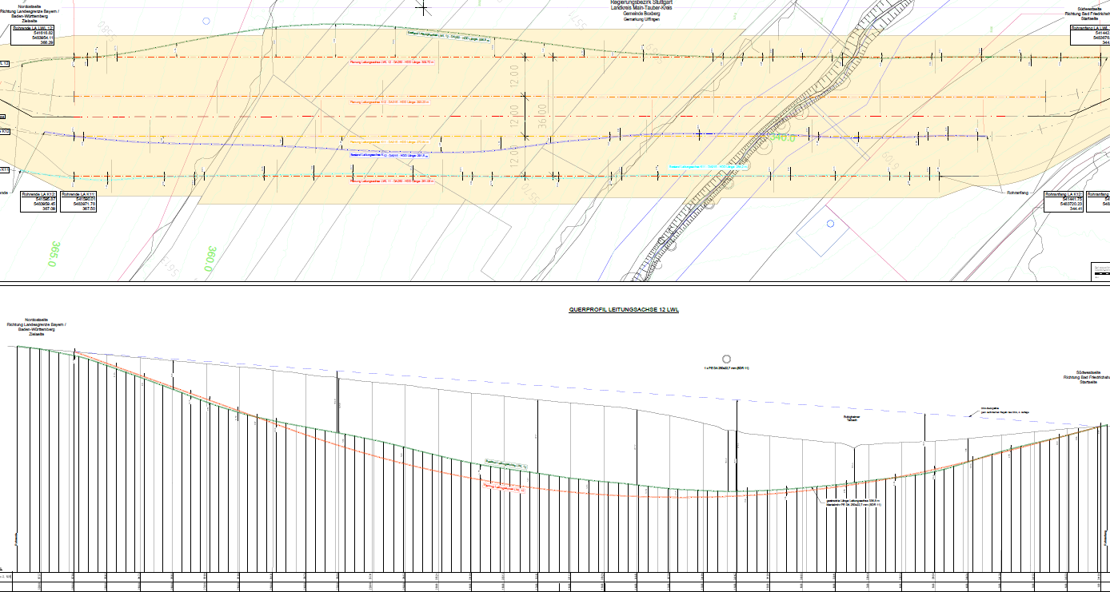
As-Built – Re-measurement with Gyro
Sudden deviation from the signal the evening before by 10m !!
-> High voltage line runs parallel!
1. Drilling with Walk-Over, Tiefe max. 24 m
Quelle:
LEONHARD WEISS GmbH & Co. KG

Slide 58
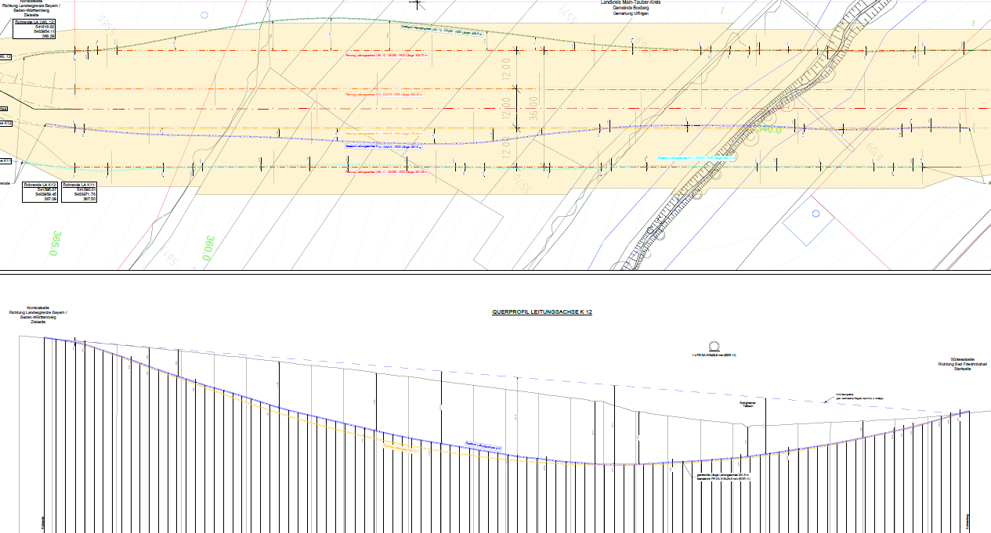
As-Built – Re-surveying with Gyro
2. Drilling with Walk-Over (100m) and then with Gyro (200m), Depth max.24 m
Quelle:
LEONHARD WEISS GmbH & Co. KG

Slide 59
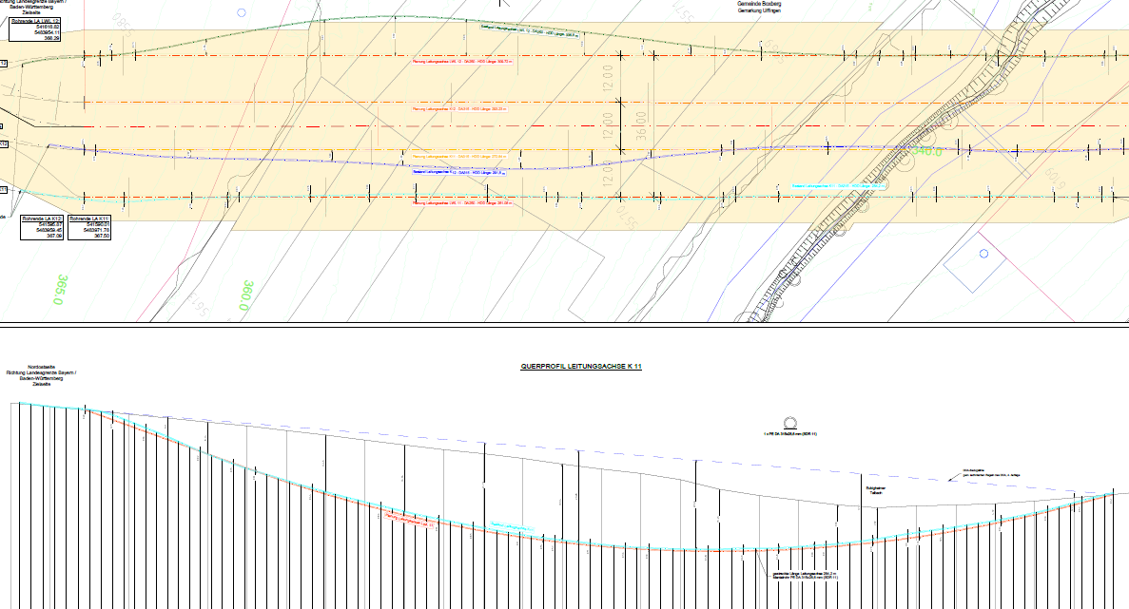
As-Built – Re-surveying with Gyro
3. Drilling with Gyro, depth max. 24 m
Quelle:
LEONHARD WEISS GmbH & Co. KG

Slide 60
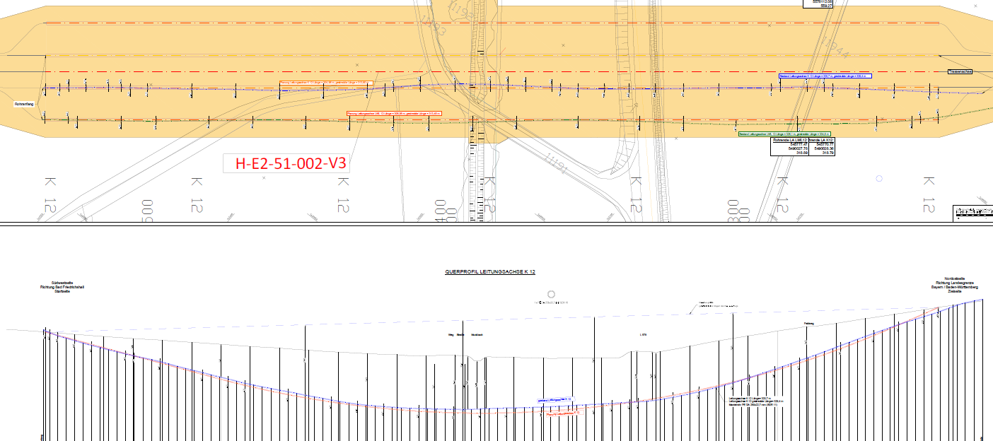
As-Built – Re-surveying with Gyro
Drilling at another location with walk-over, depth max. 18 m -> very "accurately" drilled despite walk-over !!
Quelle:
LEONHARD WEISS GmbH & Co. KG

Slide 61
Session 4 – project examples
Project „Hangbohrung 560 m“ (no customer information)
Contractor: Bohrservice Rhein-Main, Gesellschaft für Horizontalbohrungen mbH

Slide 62
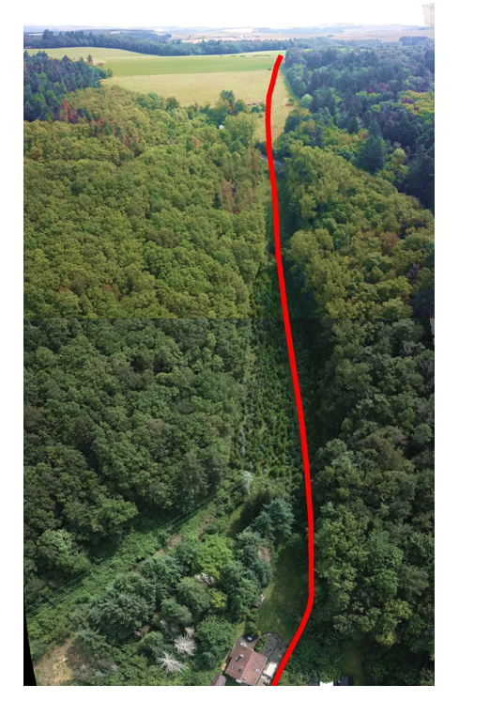
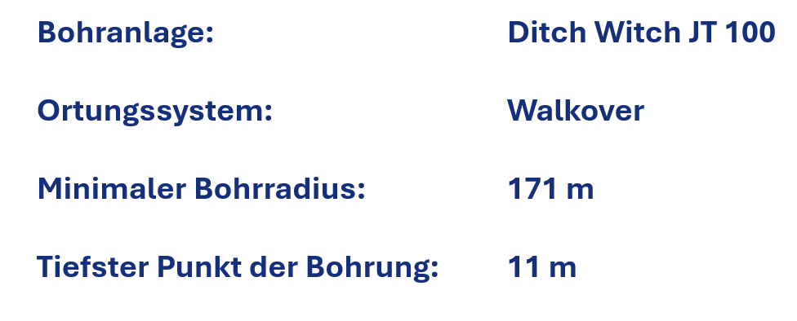
Slope drilling 560 m Ditch Witch JT 100 with walk-over location method
Drilling rig:
Positioning system:
Minimum design radius
deepest point of the borehole:
Quelle:
Bohrservice Rhein-Main, Gesellschaft für Horizontalbohrungen mbH

Slide 63
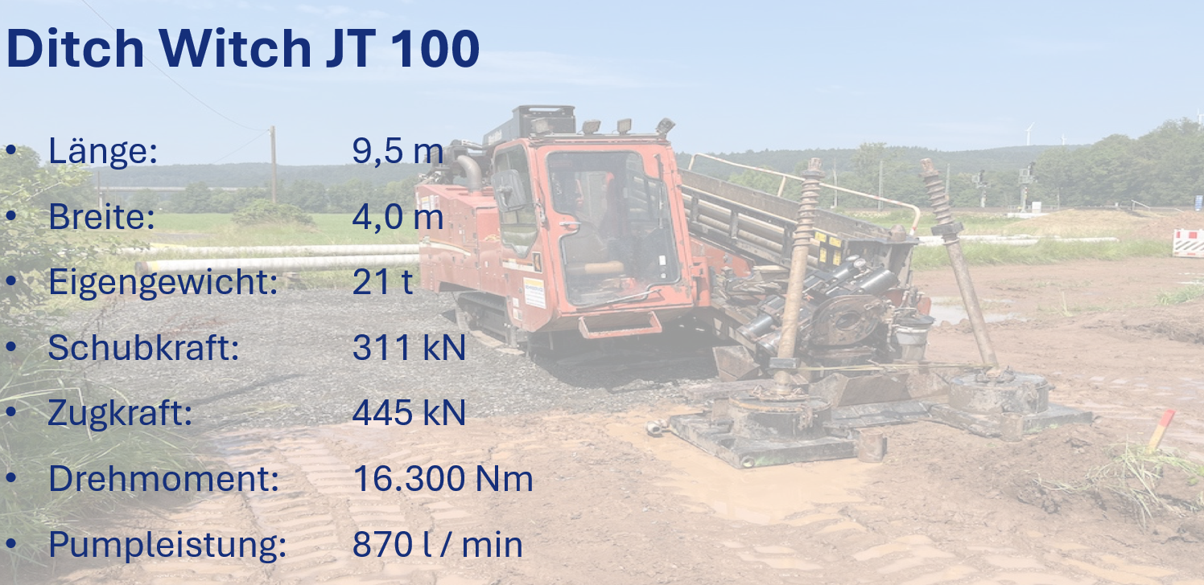
Slope drilling 560 m Ditch Witch JT 100 with walk-over location method
Quelle:
Bohrservice Rhein-Main, Gesellschaft für Horizontalbohrungen mbH

Slide 64
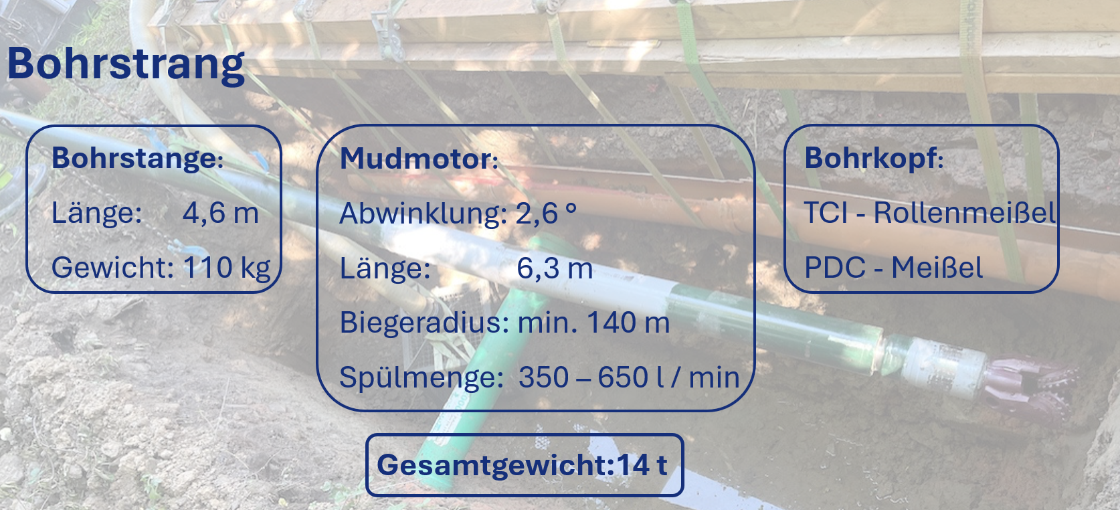
Slope drilling 560 m Ditch Witch JT 100 with walk-over location method
Quelle:
Bohrservice Rhein-Main, Gesellschaft für Horizontalbohrungen mbH

Slide 65
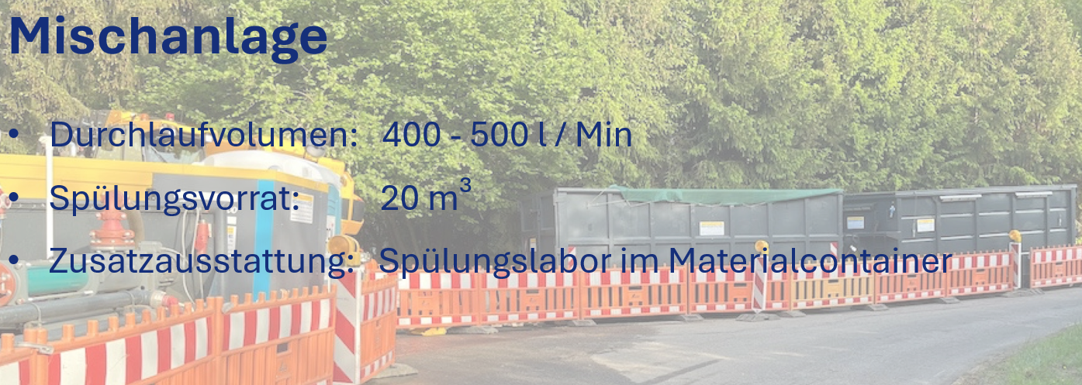
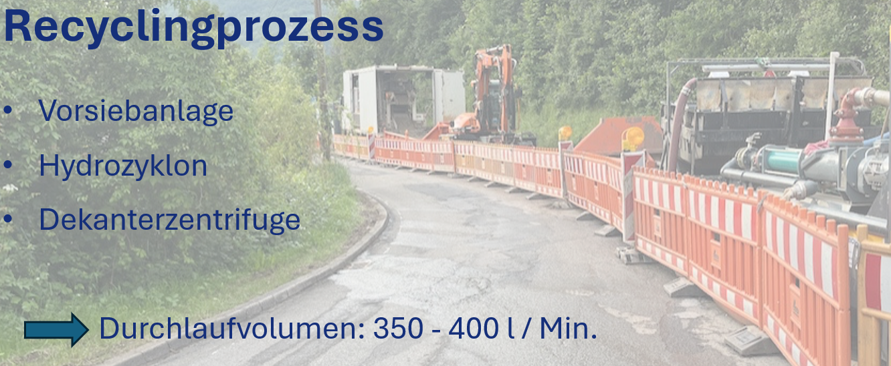
Slope drilling 560 m Ditch Witch JT 100 with walk-over location method
Quelle:
Bohrservice Rhein-Main, Gesellschaft für Horizontalbohrungen mbH

Slide 66
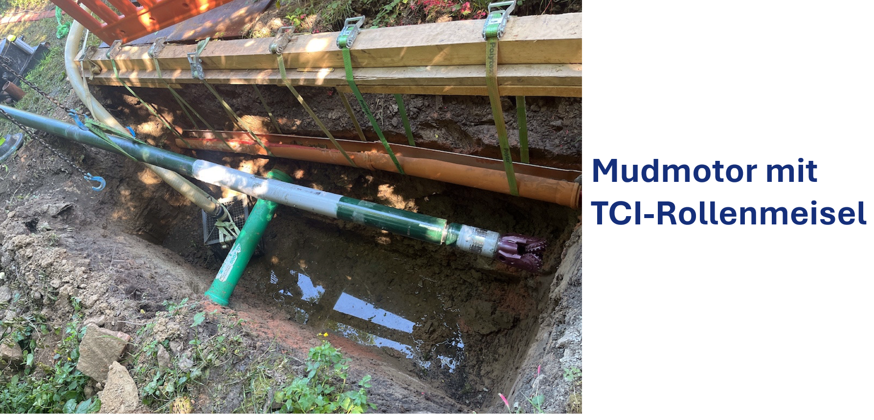
Slope drilling 560 m Ditch Witch JT 100 with walk-over location method
Quelle:
Bohrservice Rhein-Main, Gesellschaft für Horizontalbohrungen mbH

Slide 67
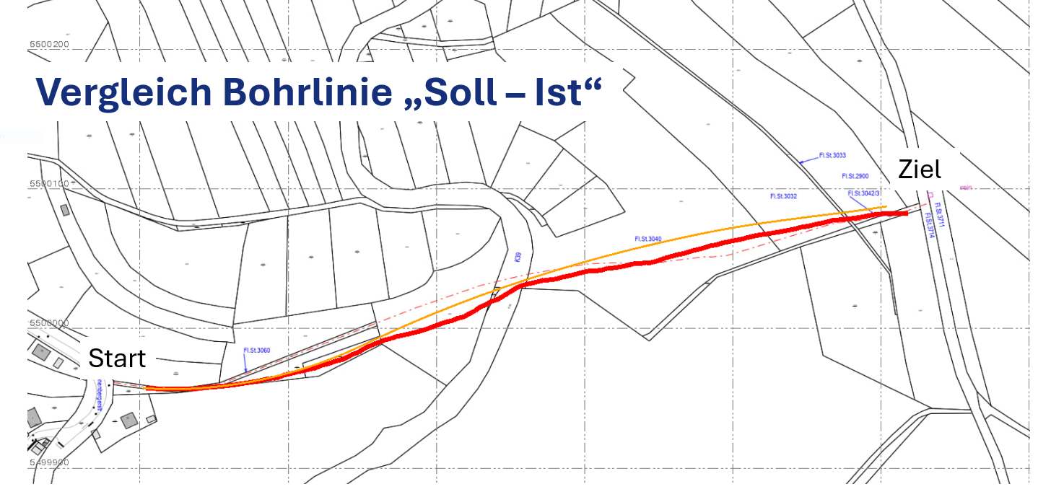
Slope drilling 560 m Ditch Witch JT 100 with walk-over location method
Design
Quelle:
Bohrservice Rhein-Main, Gesellschaft für Horizontalbohrungen mbH
As Built

Slide 68
Final discussion

